Slide 1
Data Analytics with Python
Team Ribak:
Akaniyene Akpan
(Team lead)

Slide 2
Motivation
Goal: To predict Walmart’s department-wide sales for each store.
Why:
Efficient resource allocation
Cash flow management
Costs and revenue estimation
Better decision-making
Akaniyene Akpan, Ijeoma Okeahialam, Reebal Nofal

Slide 3
Historical Data
Business data
Economic &
other data
Store
Department
Weekly Sales
Markdown
Type
Size
Weekly Sales
Holiday
Temperature
Fuel Price
CPI
Unemployment
Akaniyene Akpan, Ijeoma Okeahialam, Reebal Nofal

Slide 4
Features Plots
Akaniyene Akpan, Ijeoma Okeahialam, Reebal Nofal

Slide 5
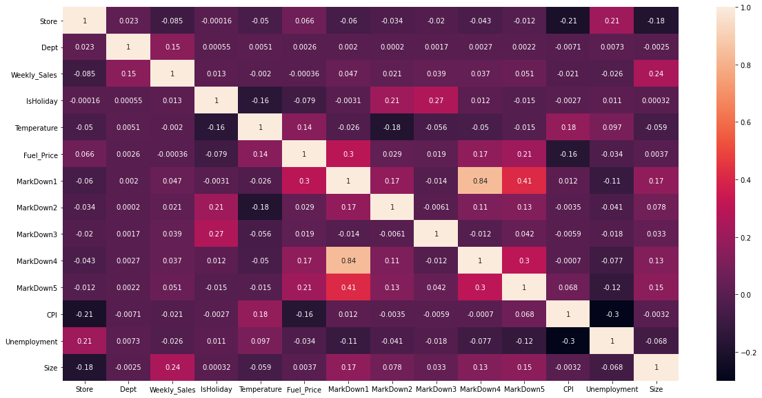
Correlation Matrix
Akaniyene Akpan, Ijeoma Okeahialam, Reebal Nofal

Slide 6
Correlation Matrix
Akaniyene Akpan, Ijeoma Okeahialam, Reebal Nofal

Slide 7
Departments
Akaniyene Akpan, Ijeoma Okeahialam, Reebal Nofal

Slide 8
Stores
Akaniyene Akpan, Ijeoma Okeahialam, Reebal Nofal

Slide 9
Size of stores
Akaniyene Akpan, Ijeoma Okeahialam, Reebal Nofal

Slide 10
Store types
Akaniyene Akpan, Ijeoma Okeahialam, Reebal Nofal

Slide 11
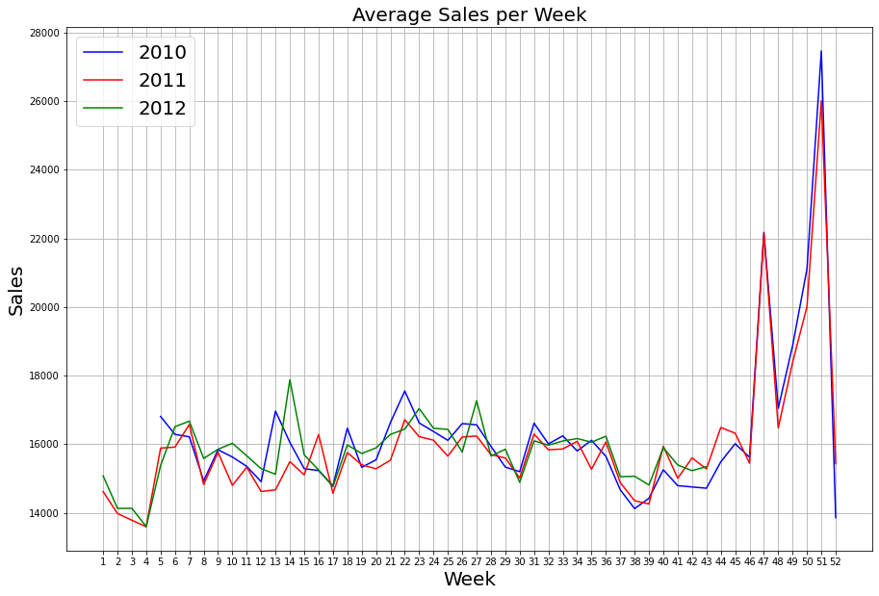
Average Weekly Sales
Akaniyene Akpan, Ijeoma Okeahialam, Reebal Nofal

Slide 12
Average Weekly Sales
Christmas
Thanksgiving
Easter
Super Bowl
Labour day
Akaniyene Akpan, Ijeoma Okeahialam, Reebal Nofal

Slide 13
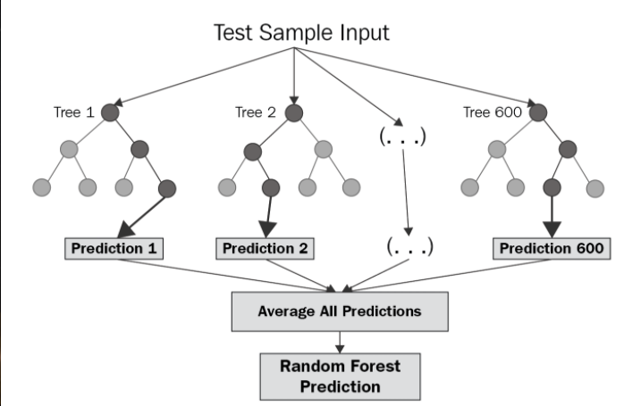
Machine Learning
Source: Google Image
Akaniyene Akpan, Ijeoma Okeahialam, Reebal Nofal

Slide 14
Machine Learning
RandomizedSearchCV
Data Training
Number of estimators: 125
Minimum sample split: 2
Minimum sample leaf:1
Maximum features: auto
Maximum depth: 125
Bootstrap: True
Base model MAE = 1305.123
Best model MAE= 1303.146
Akaniyene Akpan, Ijeoma Okeahialam, Reebal Nofal

Slide 15
Conclusion & Outlook
Conclusion
Acquainted with important python libraries
Use of optimised approach
Hyper-parameter tuning
Use of competitive platforms like Kaggle, Dataquest etc.
Outlook
Continuous learning of State-of-the-art algorithms
Practice more problems to gain better insight into the industry standards
Akaniyene Akpan, Ijeoma Okeahialam, Reebal Nofal

Slide 16
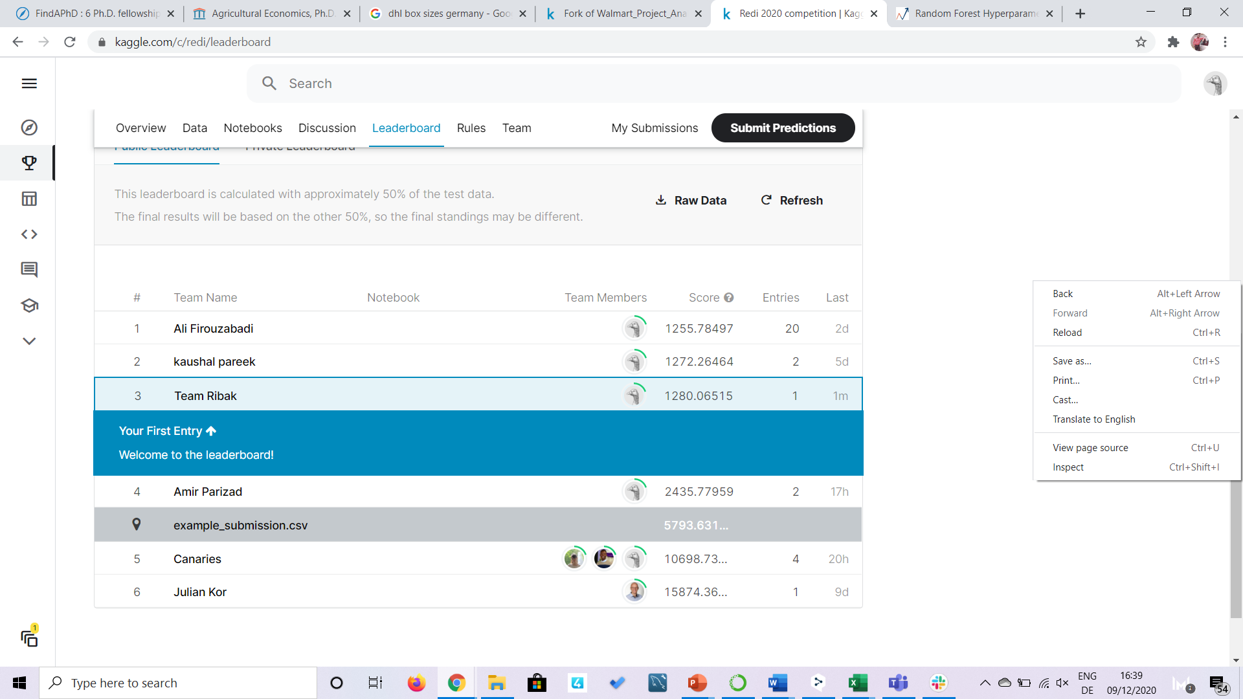
Leaderboard
Akaniyene Akpan, Ijeoma Okeahialam, Reebal Nofal

Slide 17
Thank you for your attention!
Akaniyene Akpan, Ijeoma Okeahialam, Reebal Nofal

Slide 18

Akaniyene Akpan, Ijeoma Okeahialam, Reebal Nofal

Slide 19
Appendices

Slide 20
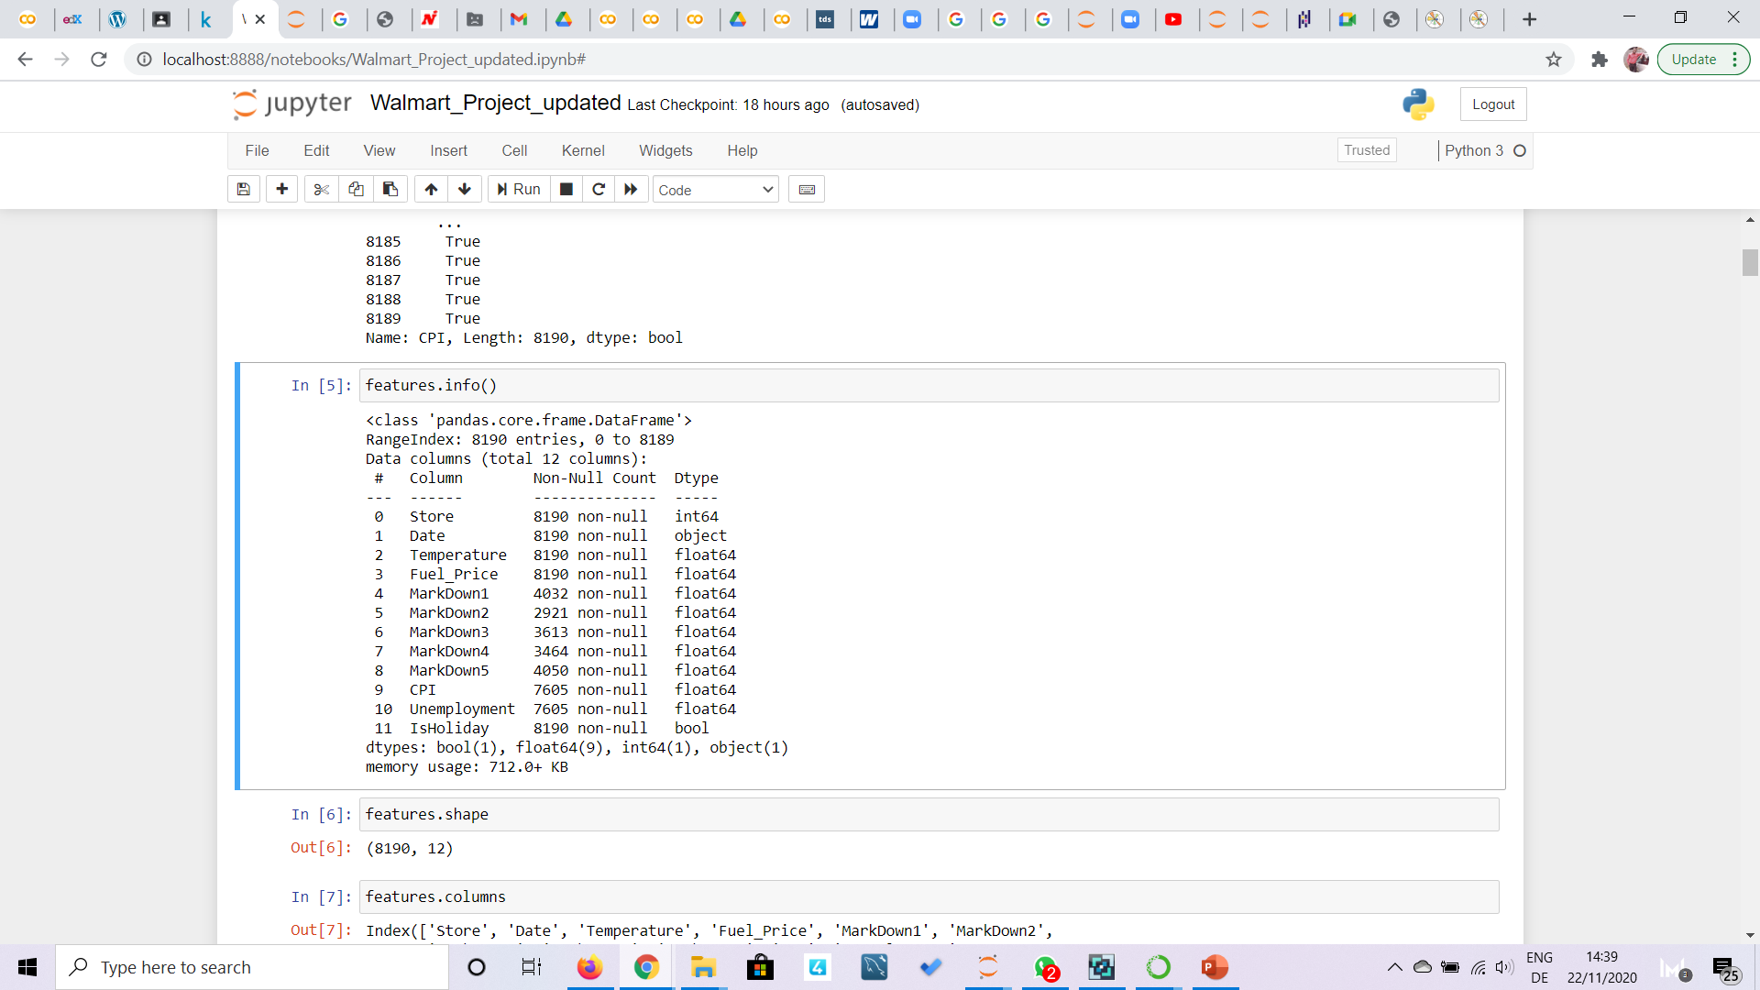
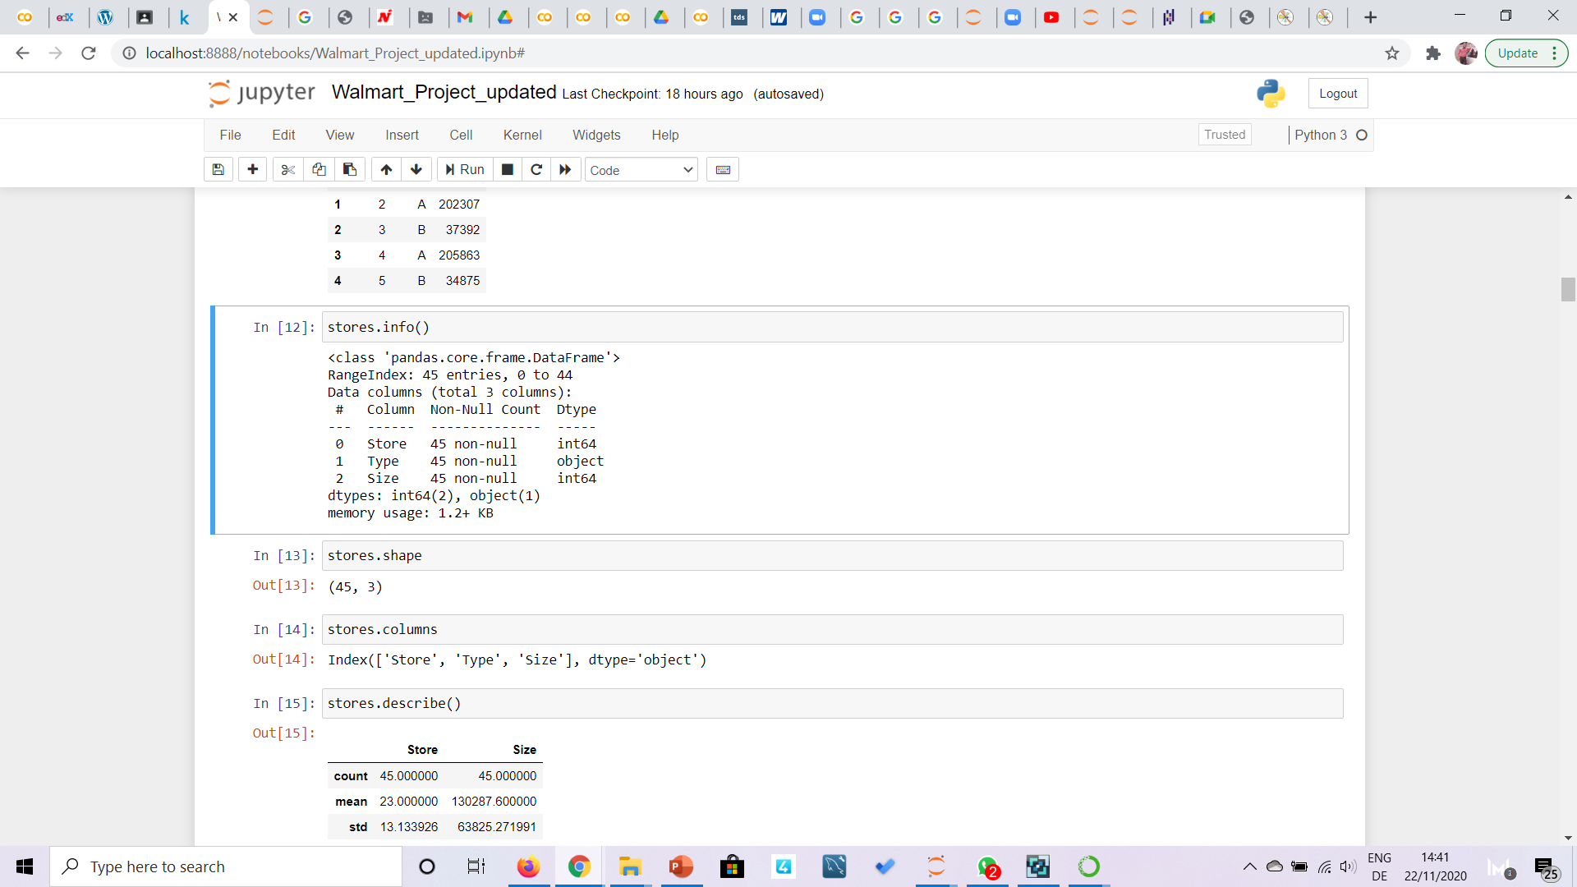
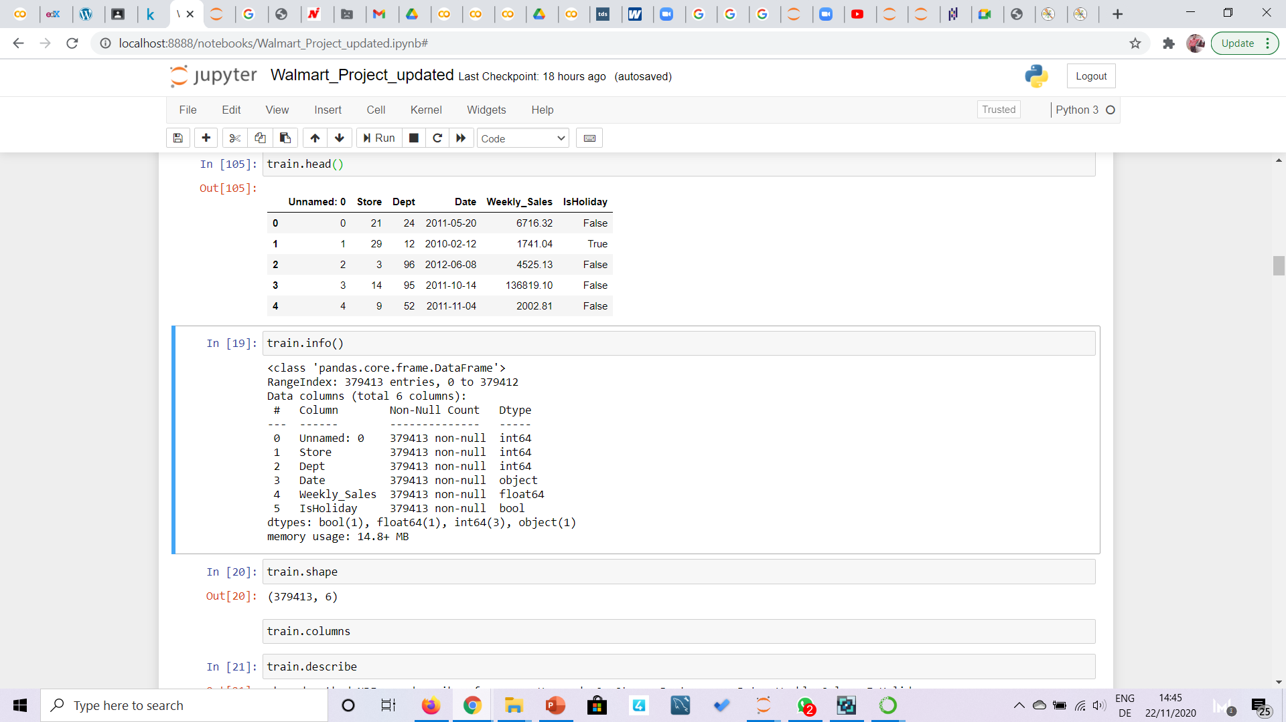
Introduction of Datasets
Akaniyene Akpan, Ijeoma Okeahialam, Reebal Nofal

Slide 21
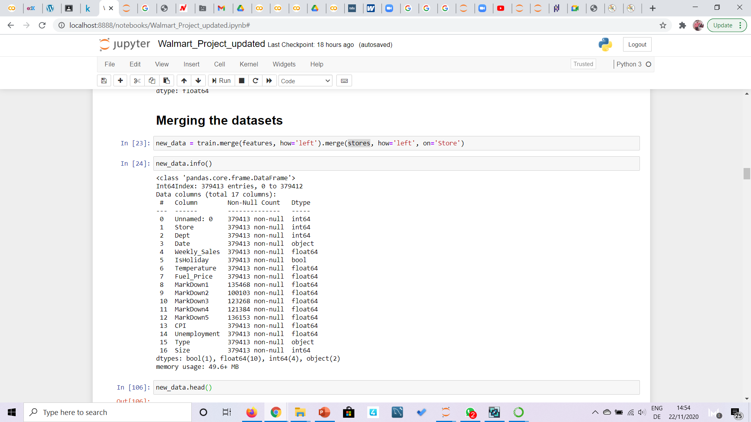
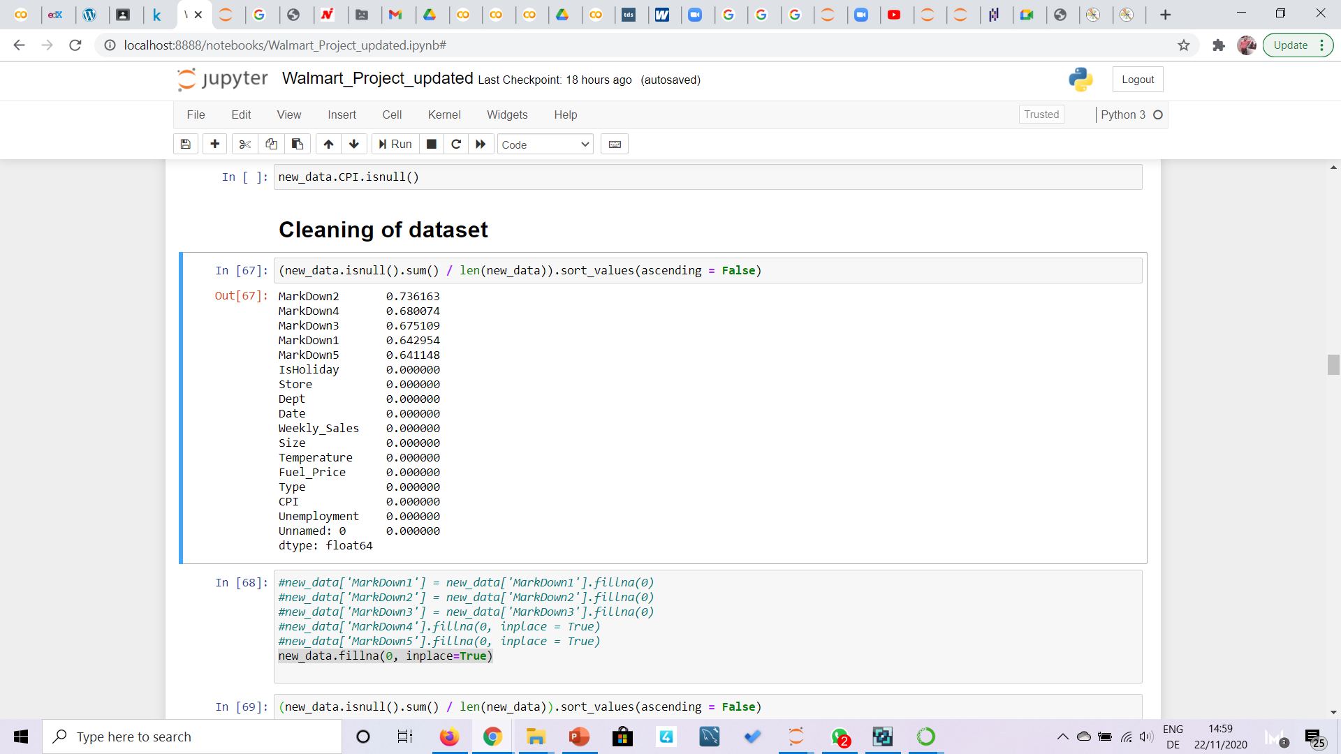
Merging and Cleaning of Datasets
Information on merged Dataset
The ratio of null values in the merged in new data
Akaniyene Akpan, Ijeoma Okeahialam, Reebal Nofal

Slide 22
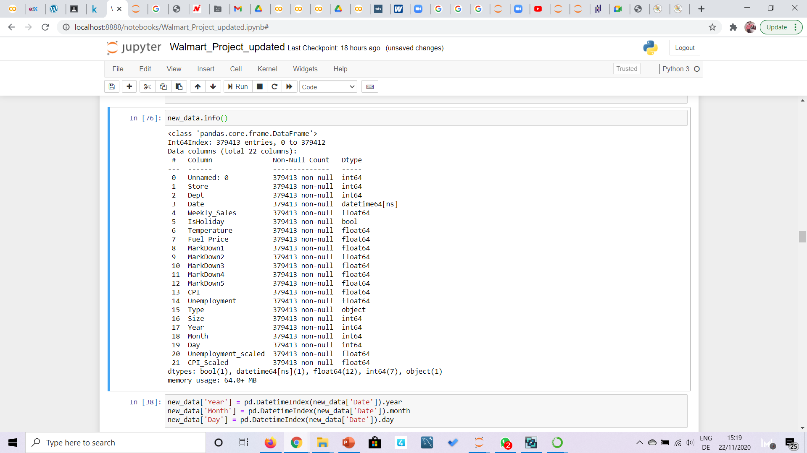
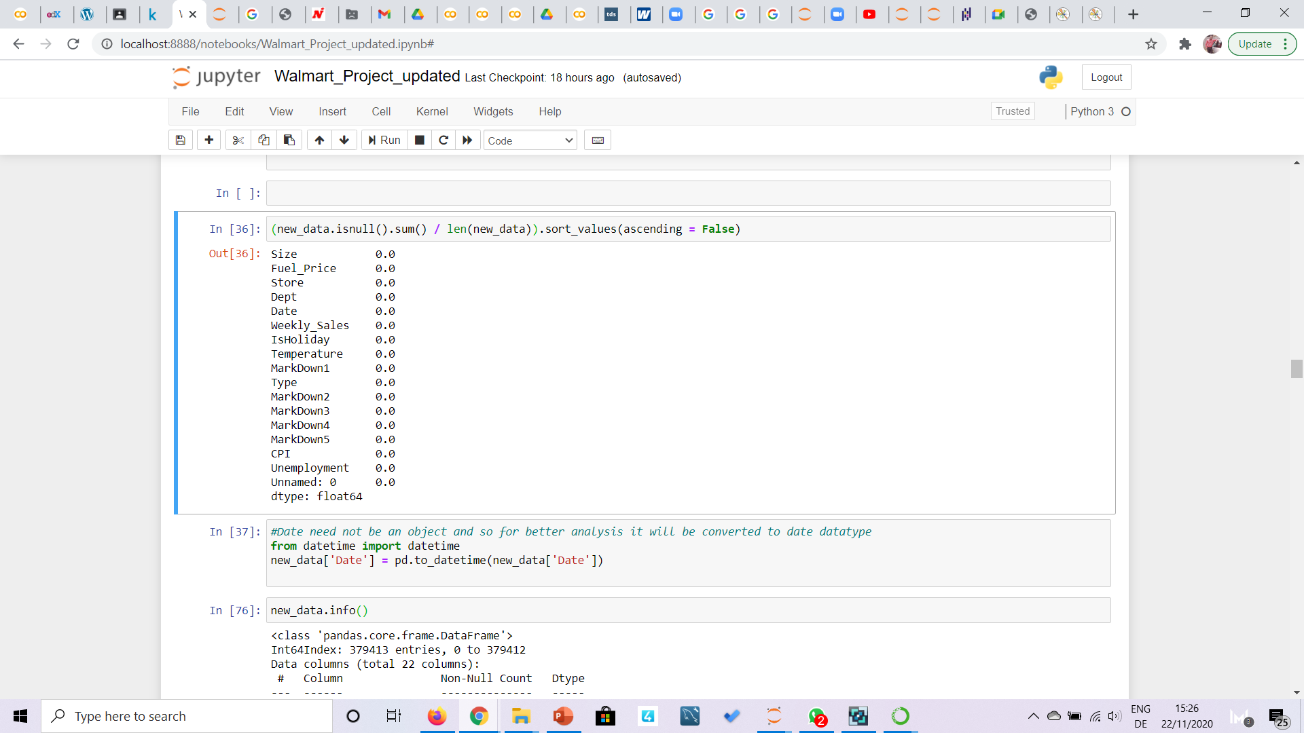
Merging and Cleaning of Datasets
Akaniyene Akpan, Ijeoma Okeahialam, Reebal Nofal

